Slide 1
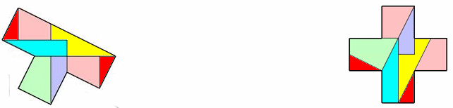
Loyd Polyominoes
Donald Bell
donald@marchland.org
M500
Nottingham
January 2019
more details and downloads on the web page:
http://www.marchland.org/loyd

Slide 2

in the Gift Exchange, G4G13, Atlanta, 2018

Slide 3
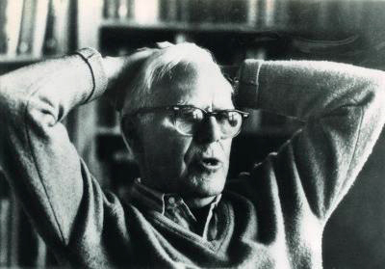
Martin Gardner
(October 21, 1914 to May 22, 2010)
Wikipedia : American popular mathematics and science writer, with interests also encompassing scientific skepticism, micromagic, philosophy, religion, and literature.
Gatherings for Gardner
Many small events on or near 21 October each year, called "Celebration of Mind"
Big G4G event in Atlanta every two years

Slide 4
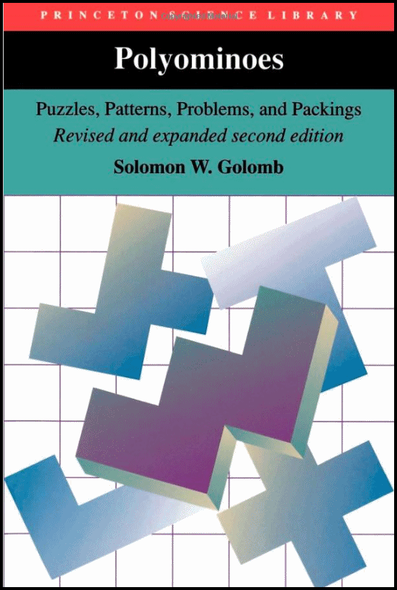
Polyominoes
Since a "domino" has two squares, Solomon Golomb invented the word "polyominoes" to describe shapes which are made of several squares joined by complete edges.
So there are "triominoes", "tetrominoes", "pentominoes" etc
His book on the subject is a classic.

Slide 5
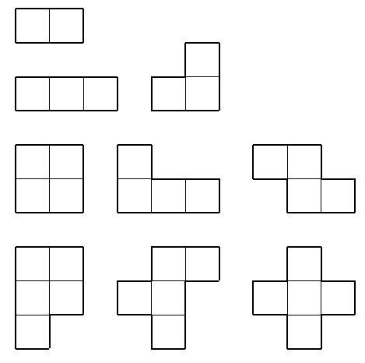
The “tetrominoes” and “pentominoes”
A “domino” has 2 squares. There is only one shape of domino.
A “triomino” has 3 squares and there are 2 shapes of triomino.
A “tetromino” has 4 squares and there are 5 shapes of tetromino.
A “pentomino” has 5 squares, there are 12 shapes of pentomino.

Slide 6
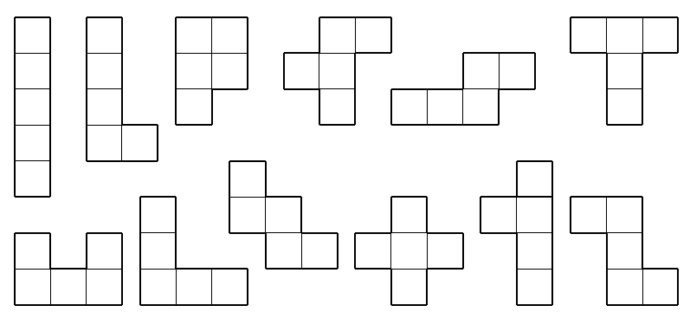
The “pentominoes”
Here is the full set of pentominoes, each has 5 squares
The pentominoes are usually known by their letter shapes.
I, L, P, R, S, T, U, V, W, X, Y, Z (the “R” is sometimes called “F”)

Slide 7

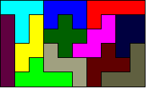
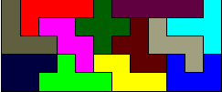

The 12 pentominoes together have 60 squares. They can be assembled into rectangles of 3x20, 4x15, 5x12 and 6x10 like this. There are thousands of solutions, but it is still quite difficult to find just one.

Slide 8
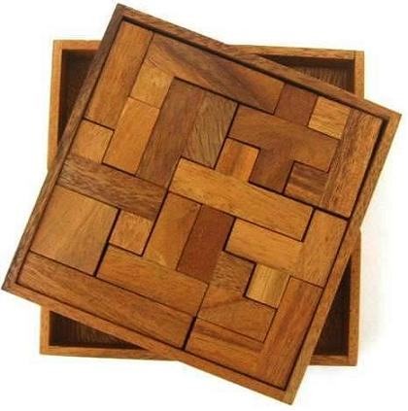
Pentomino Puzzle
Commercial pentomino puzzles usually have an additional 2x2 square piece, so that an 8x8 pattern can be made.

Slide 9
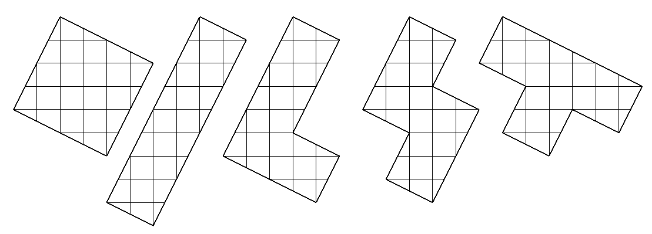
The “tetrominoes”
The five tetrominoes are known as "square", I, L, S and T. Sometimes the letter O is used for the square.
Each one is made up of four squares, but they are drawn here sloping and superimposed on a grid, which will be useful later.

Slide 10
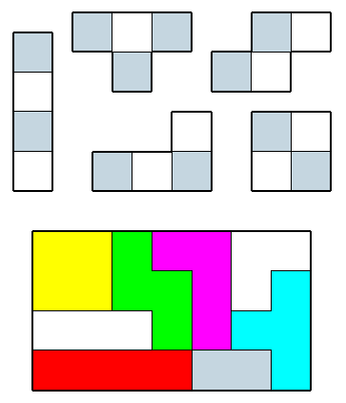
The five tetrominoes have a total of 20 squares, but they cannot form a 4x5 or 2 x 10 rectangle.
If the pieces are chequered, it can be seen that all of the pieces except the T-tetromino have equal black and white squares, but the T-tetromino has three of one and one of the other.
However, if the two triominoes and a domino are added, then a 7x4 rectangle can be formed. All the small polyominoes.

Slide 11
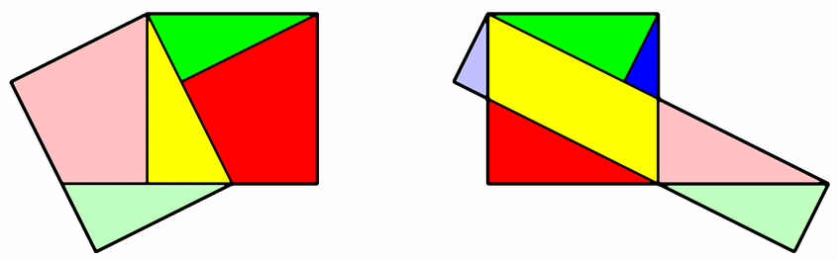
Montucla’s Dissection
"Recreational Mathematics" in the 18th and 19th century often consisted of geometric dissections.
The French mathematician Jean-Etienne Montucla (1725 – 1799) showed how to decompose a square into pieces and reassemble them into a rectangle. Usually only three pieces are needed, unless the target rectangle is long and thin.

Slide 12
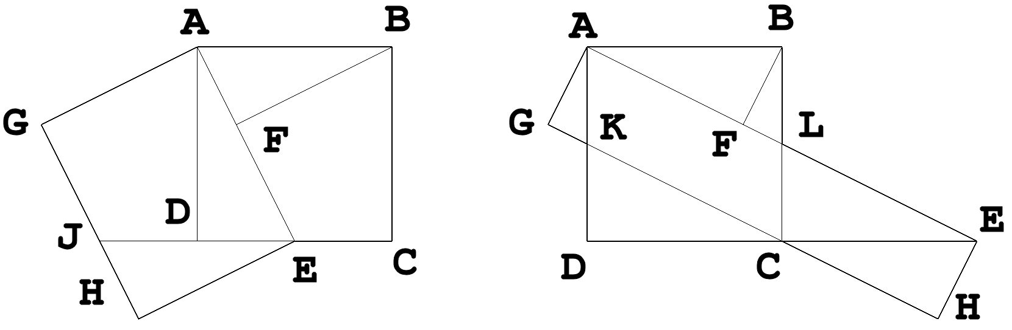
Geometry of Montucla’s dissection
The line AE is the length of the long side of the rectangle.
Triangles ADE and BFA are similar, so AE*BF = AB*AD
And so BF is the short side of the rectangle, equal to AG and EH.
In the left diagram, DE has been made equal to DC / 2
In the right diagram DE has been made equal to 2*DC
In this case AE = 5 * AG. Triangle ADE has sides [1, 2, √5]

Slide 13
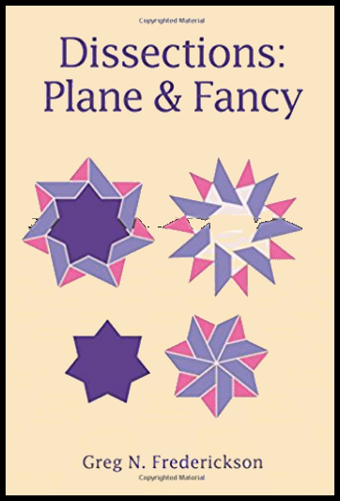
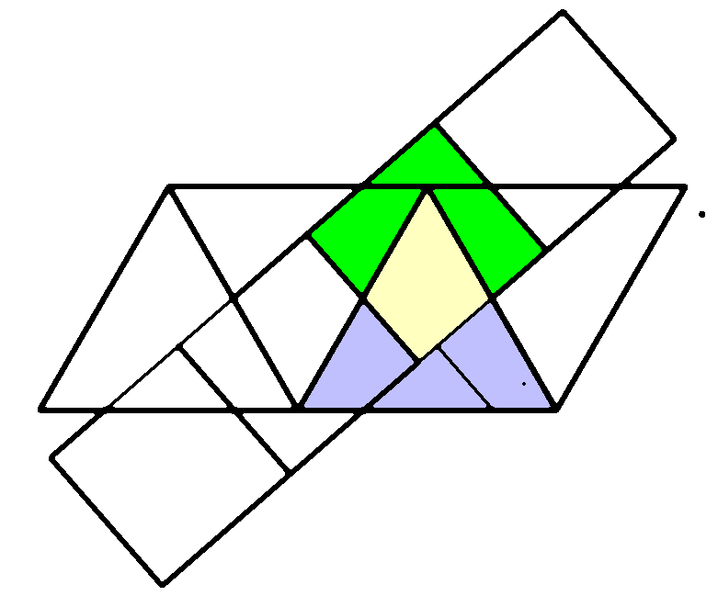
Dissections
There are lots of ways of dissecting one geometric shape into another.
This is a popular work on the subject:
“Dissections: plane and fancy” by Greg Frederickson.
Here is how you can dissect an equilateral triangle into a square. Overlay strips of squares and triangles. Change the positions and angles until something “interesting” appears.

Slide 14
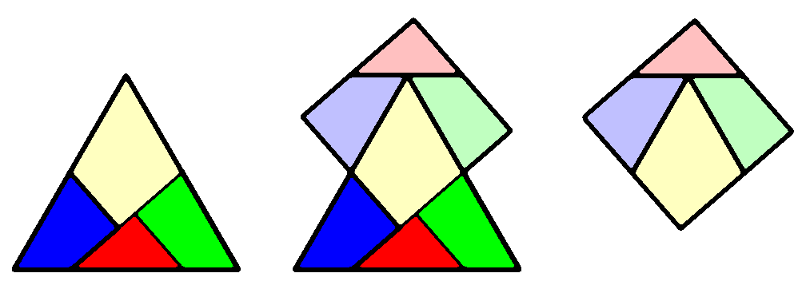
Dissecting the equilateral triangle into a square.
This one, by Henry Ernest Dudeney (1857 – 1930), also has the unusual property that the pieces can be hinged at their corners.
The challenge in most dissections is to use as few pieces as possible, just four in this case.

Slide 15
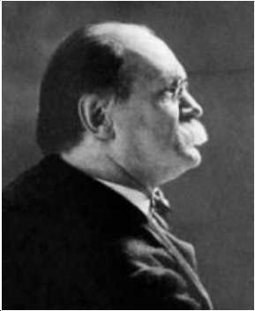
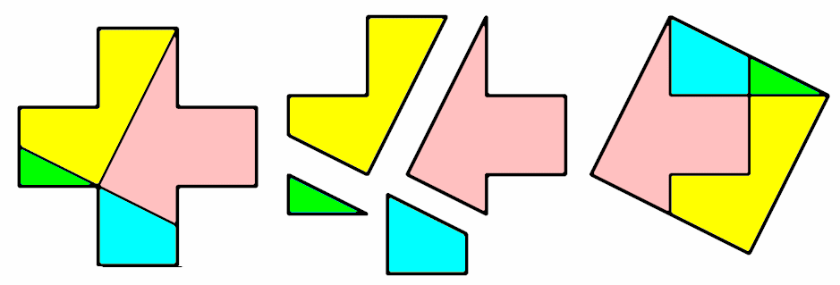
This classic dissection of a cross to a square was the basis of some puzzles in the 19th Century. Usually attributed to Sam Loyd (1841-1911), a prolific puzzle designer.

Slide 16
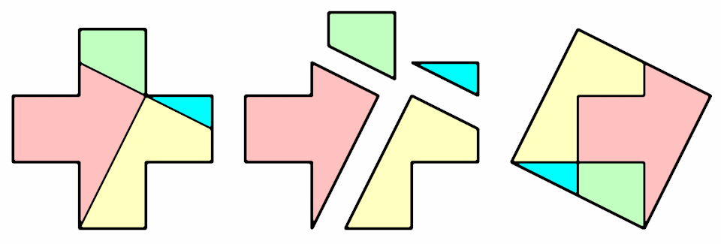
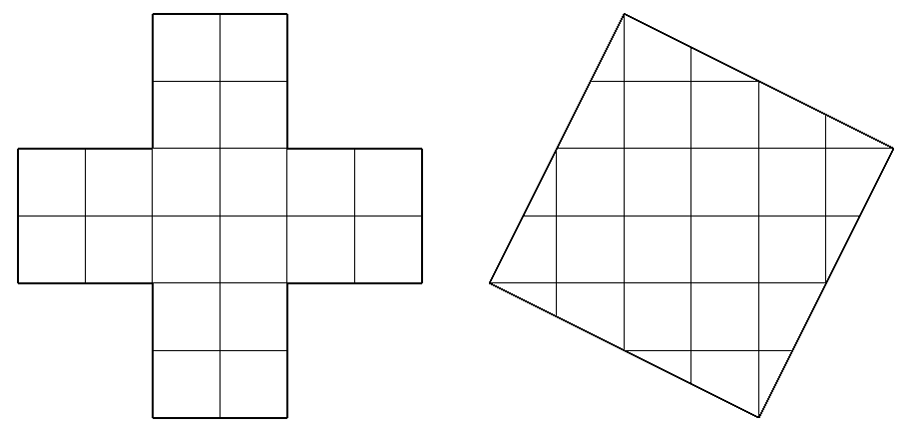
Sam Loyd’s dissection
of a Greek Cross to a Square
If the cross is 6x6, then it has 20 unit squares.
So the side of the big square is √20 or 2√5

Slide 17
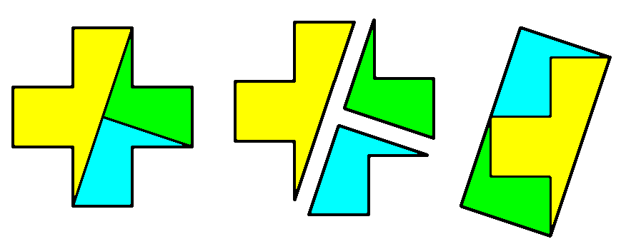
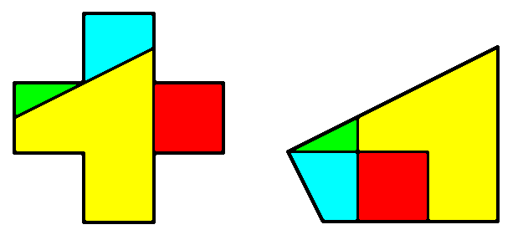
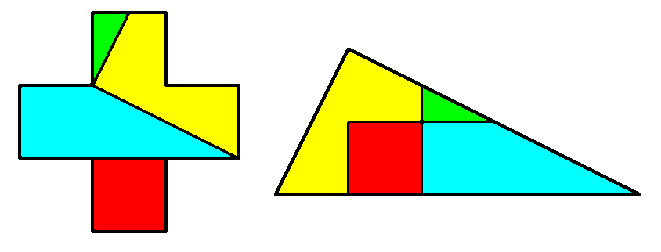
Sam Loyd also showed how to dissect a cross to a domino (a 2x1 rectangle), a quadrilateral and a triangle.

Slide 18
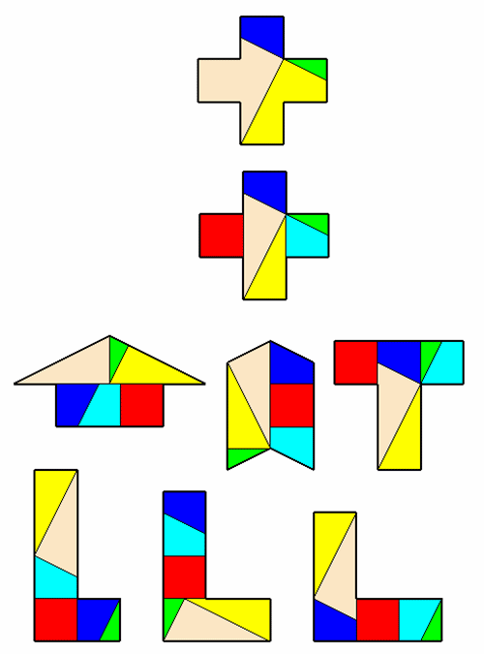
The four piece dissection of the Greek cross has two large complex pieces (pink and yellow)
Each of these can be cut in two to make simpler pieces.
The set of six pieces
makes a "Multipuzzle"
which can form many
interesting shapes.

Slide 19
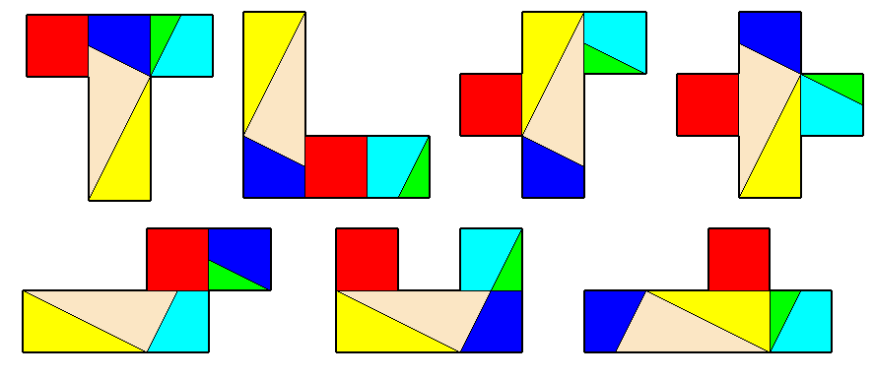
Using the six pieces from the "Multipuzzle" to make pentominoes
Most of the twelve pentominoes can be made using the six pieces of the Multipuzzle.
The W-pentomino is the only one which cannot be made.

Slide 20
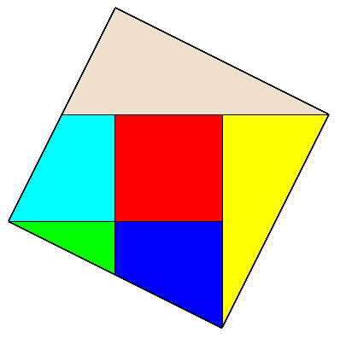
But the square is the ONLY tetromino which can be made with the six Multipuzzle pieces.
The perimeters of the other tetrominoes are longer and there are not enough suitable edges in the group of pieces.

Slide 21
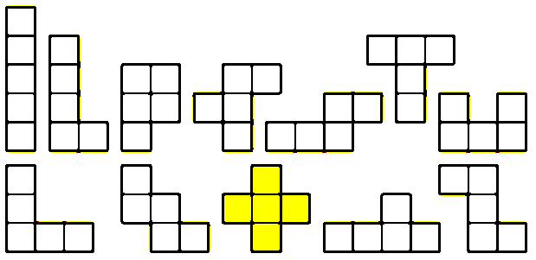
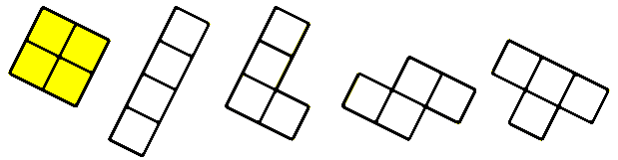
Dissection of Pentominoes into Tetrominoes
There are twelve pentominoes, each made of five squares.
And five tetrominoes, each made of four (slightly larger) squares.
So there are sixty different dissections of a pentomino into a tetromino

Slide 22
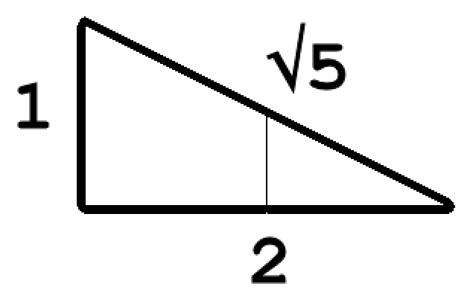
Dissection of a Greek Cross to a Square
One of the twelve pentominoes (the X-pentomino or Greek Cross) is dissected into one of the five tetrominoes.
Note the little green triangle, with sides
[1, 2, √5]. It occurs a lot in this project.
Is there a Universal Dissection of all twelve of the pentominoes into all five of the tetrominoes?
A very difficult dissection!

Slide 23
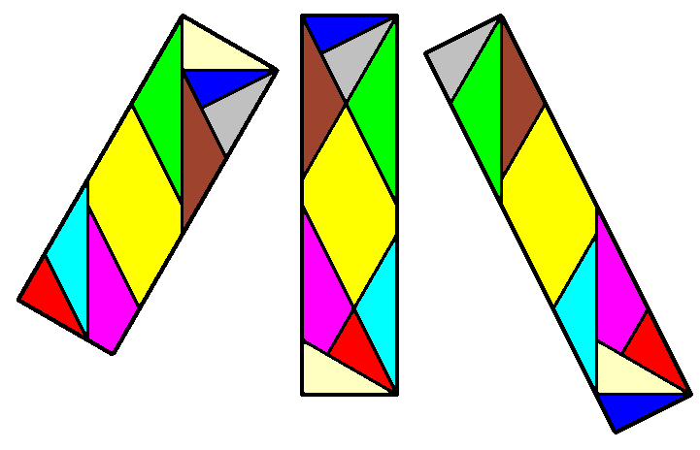
An Example of Multiple Dissections
These nine pieces can make three different rectangles. Their aspect ratios are 3:1, 4:1 and 5:1.
They were designed using Montucla's Dissection repeatedly.

Slide 24
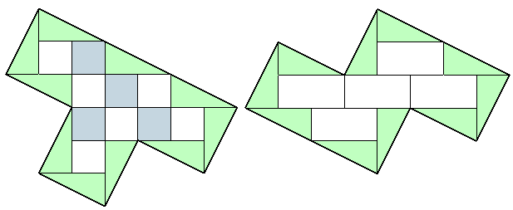
Making all 17 of the polyominoes
20 small triangles can make all 12 of the pentominoes and 4 of the tetrominoes. The exception is the T‑tetromino.
But if an even number of these triangles is replaced by an equal number of unit squares, then all of the polyominoes can be made. Can this number of pieces be made less than 20?

Slide 25
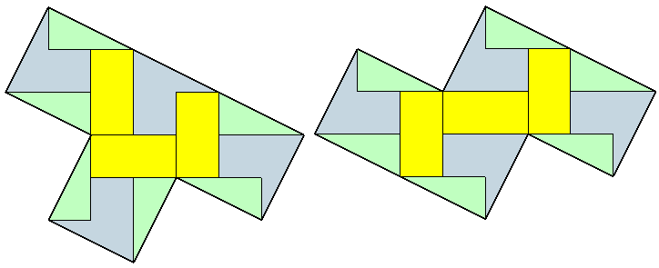
For the tetrominoes, there are usually 10 triangles around the perimeter and the other pieces fill the interior.
By combining some building blocks in pairs, the number of pieces needed can be reduced from 20 to about 13, as shown for the T and S tetrominoes.
But it is difficult to get any lower using this method.
And we need to get a lot lower!

Slide 26
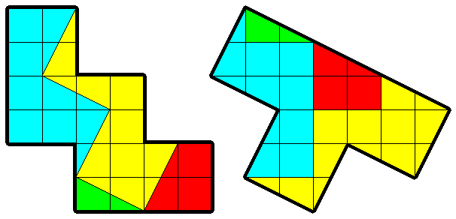
Research at Politecnico di Torino
A research group at the Politecnico di Torino, Italy, has demonstrated the sixty dissections of every pentomino into every tetromino with small numbers of pieces.
http://www.iread.it/Poly/tepe_diss_en.php
Here, for example, is their dissection of the W pentomino to the T tetromino in only four pieces.

Slide 27
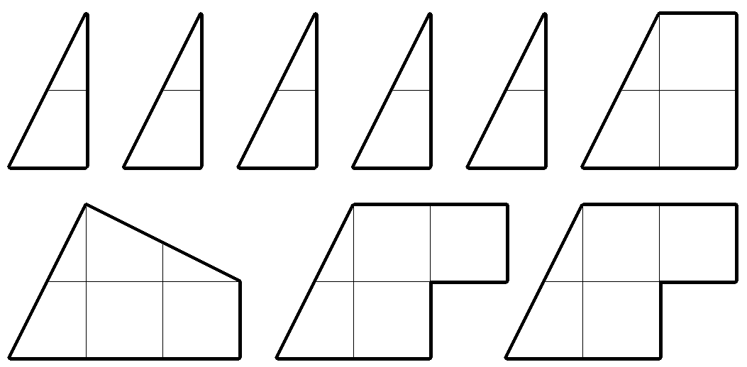
Research Group at Politecnico di Torino
The team also found this group of just nine pieces that could be assembled to make all of the tetrominoes and all of the pentominoes (i.e., all 17 of the Loyd Polyominoes).
It has five small triangles, a trapezium, a quadrilateral and two "dalek" shapes.

Slide 28
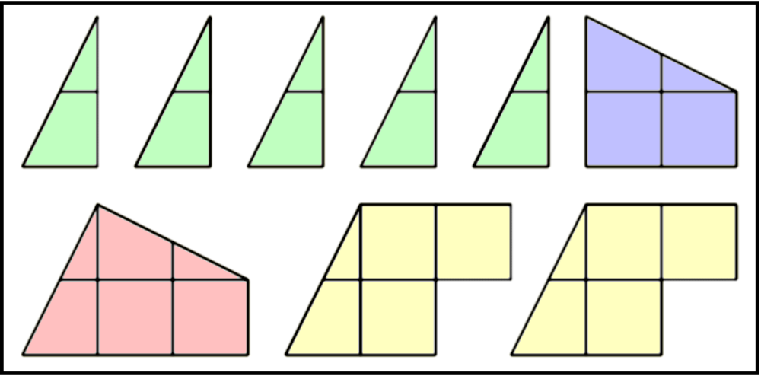
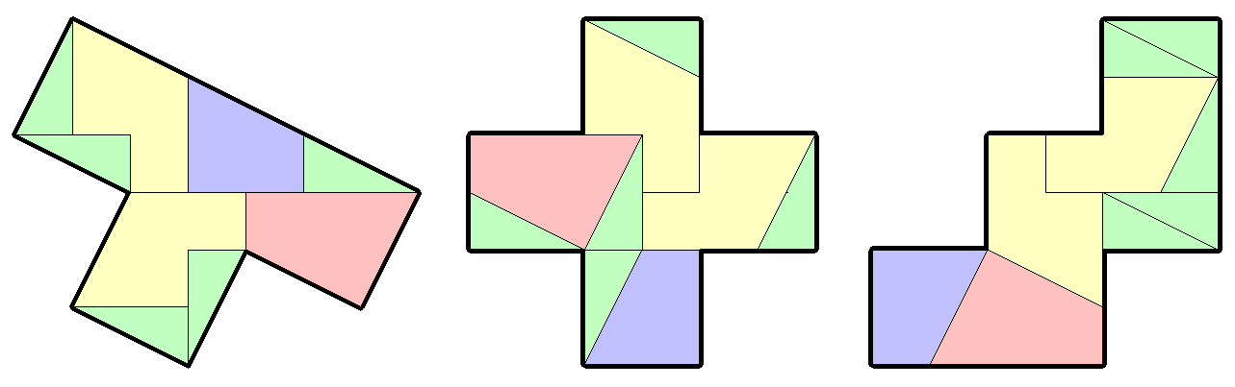
The group of nine pieces from
Politecnico di Torino
With three of the
most troublesome
target shapes –
T-tetromino,
X-pentomino
W-pentomino

Slide 29
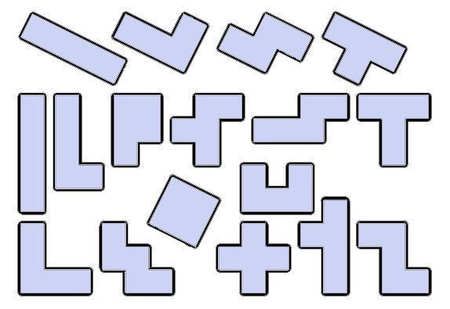
The Loyd Polyominoes – the Challenge
Is there another set of pieces that can make all seventeen of these polyomino shapes?

Slide 30
The Loyd Polyominoes – the challenge
Ideally the new set of pieces should
have nine pieces that are all different
or have only eight pieces
better still, have only eight pieces, all different
So what is the best search technique?
Start with some small triangles and unit squares and progressively combine them into larger pieces
Find a set of pieces that will make at least some of the seventeen polyominoes and then try to "improve" it
Find a simpler problem and solve that one first (a true engineer's approach)

Slide 31
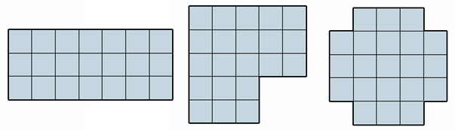
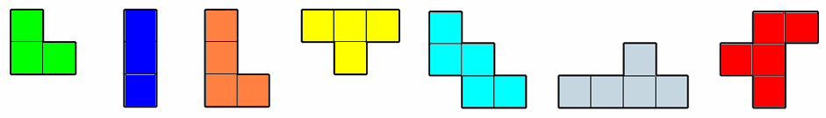
Solving a much easier problem first
Suppose there are just three target shapes – called “block”, “gamma” and “cross”. Find their Universal Dissection.
Using seven plausible puzzle pieces called V, I, L, T, W, Y, R.
Each target shape has an area of 21 squares. The total area of all seven of the plausible puzzle pieces is 29, so some pieces will be left out of any solution.

Slide 32
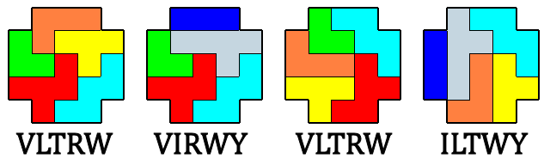
Solutions for the "cross" target shape
Some of the many solutions for the "cross" target shape.
The group of pieces for the first and third solutions is VLTRW, and the groups for the other solutions are shown.
But although there are many solutions, there are only three different groups of pieces – VLTRW, VIRWY, ILTWY.
So this is a mathematical "set" with 3 distinct members.

Slide 33
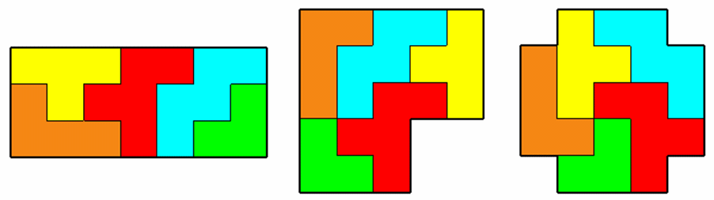
The shape called “block” has many solutions but just three possible groups of pieces:
VLTRY , VLTRW , ILTRY
And for “gamma”, there are also three possible groups:
VLTRW , ILTRY , VLTWY
And for “cross” the set of groups is:
VLTRW , VIRWY , ILTWY
So the group of pieces in every set is VLTRW
The pieces I and Y are not needed

Slide 34
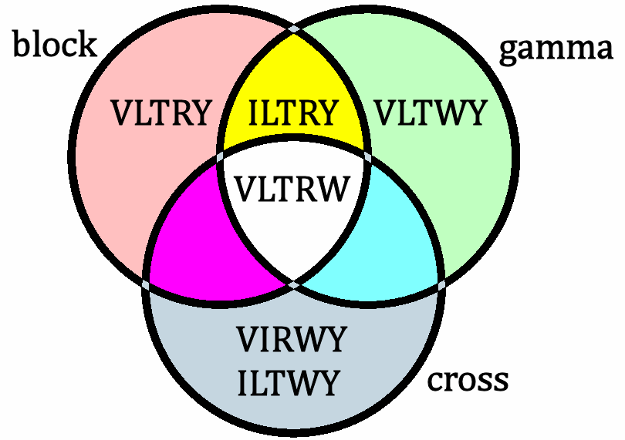
The Venn diagram shows the same information.
Each circle is a set of groups of pieces.
So the one group of puzzle pieces common to block, gamma and cross is VLTRW in the middle.

Slide 35
And now for the big problems!
(See : www.marchland.org/loyd for details)
The tasks to be done:
Moving from three target shapes to seventeen
and from seven plausible pieces to over thirty.
Using the famous Burr Tools
program and providing data to
let it work on [1, 2, √5] triangles.
Getting results out of Burr
Tools in huge text files.
Analysing those results to find sets of groups.
And limiting the search process to what a small laptop can cope with.

Slide 36
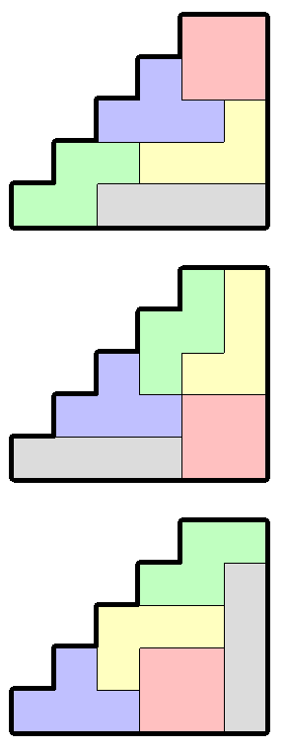
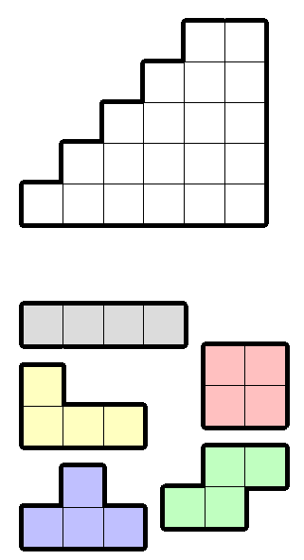


Burr Tools for solving Polyomino puzzles
Define the target shape and the shapes of the pieces
Feed in to Burr Tools
Get the solution(s)

Slide 37
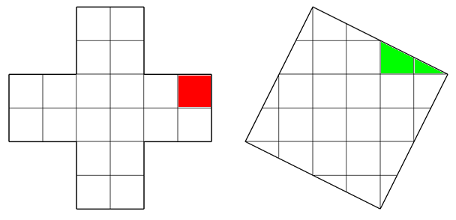
Searching for a group of pieces that can demonstrate a Universal Polyomino Dissection
The building blocks for the pieces are the unit square (red) and the small triangle (green).
But there are dozens of plausible puzzle pieces!
Which ones should be included? (the computer can't just use them all)

Slide 38
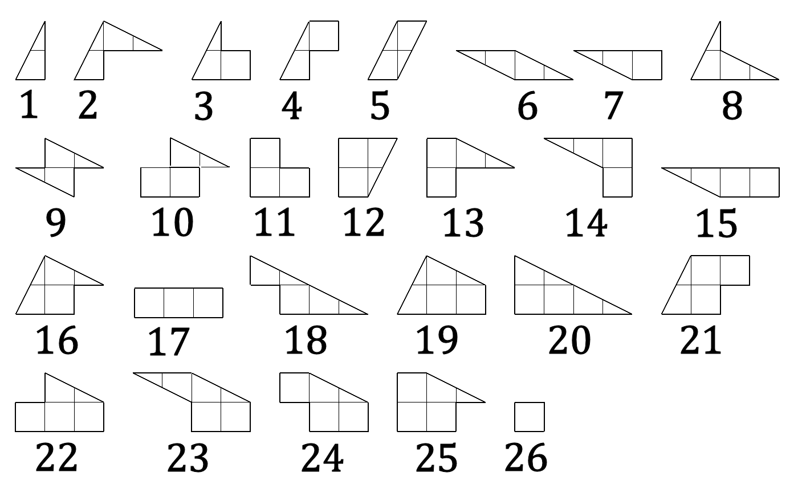
The number of possible shapes for puzzle pieces is quite large. And there may be more. All of these shapes will fit inside all of the tetrominos and pentominos. Some computer help with the “heavy lifting” is clearly required.

Slide 39
Outline of the computer assisted approach
Define the shapes of all the plausible puzzle pieces and target polyomino shapes
Then for each of the 17 polyominoes:
  feed the polyomino target shape plus the shapes of all the plausible puzzle pieces into Burr Tools according to some criterion (eg “no double pieces”)
  Record all the solutions (there may be a lot)
  Distil out into a “set” all the different groups of pieces that will make that one polyomino shape
Now we have 17 “sets” of groups of pieces – each set may have thousands of members
Form the “intersection” of these sets and look at the groups of pieces that work for all 17 polyominoes.

Slide 40
Some of the Computer Problems
Burr Tools is not well adapted to dealing with these geometric shapes. It normally works on squares and cubes.
And it produces its output as large XML files. Very suitable for graphics but they need to be "parsed" and then processed with some tailor-made Python programs.
For each choice of "plausible" pieces, Burr Tools has to be run 17 times (or 24 counting polyomino mirror images).
The data sets can grow without limit unless some "human intervention" is applied to the choice of plausible pieces.

Slide 41
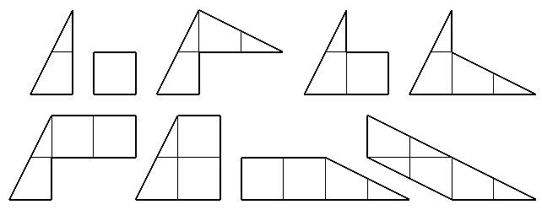
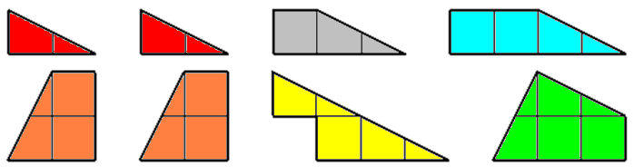
Loyd Polyominoes Project – some results for the Universal Polyomino Dissection
Nine-piece group – all pieces different
------------------------------------------------------------------
Eight-piece group – two pairs and four other pieces.
There are (at least) two other eight-piece groups.

Slide 42
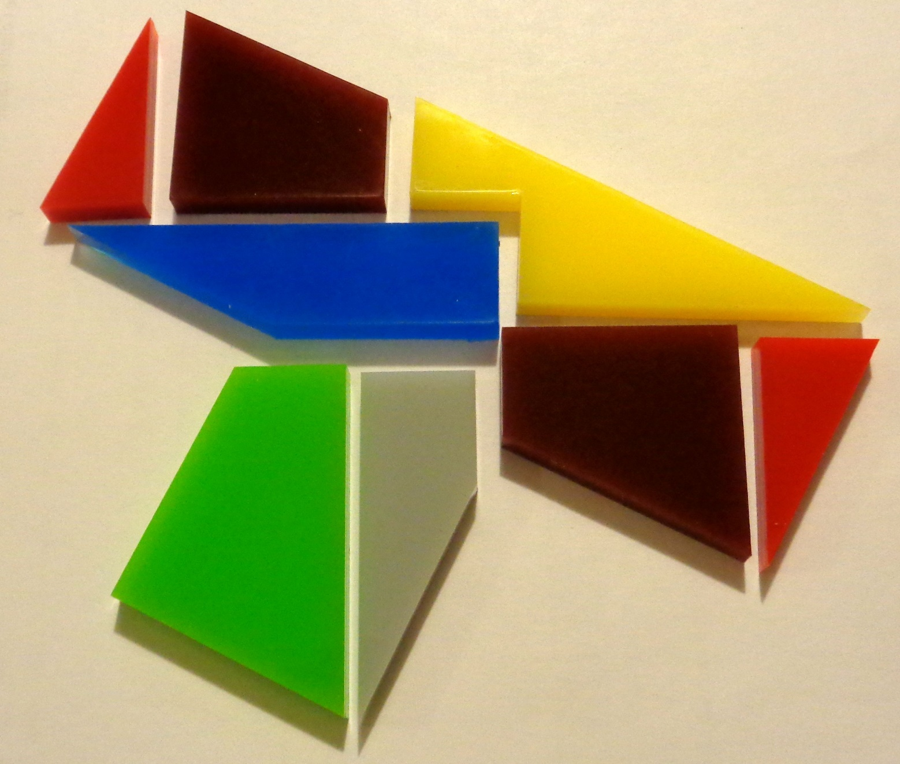
The group of eight pieces making a T-tetromino

Slide 43
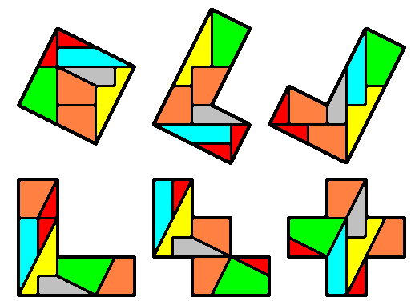
The group of eight pieces can make all of the 17 polyominoes (and most of the mirror shapes, too)
Is there a group of eight pieces, all different, that gives a Universal Polyomino Dissection?
(if there is, it's still waiting to be found)
Project page : www.marchland.org/loyd

Slide 44
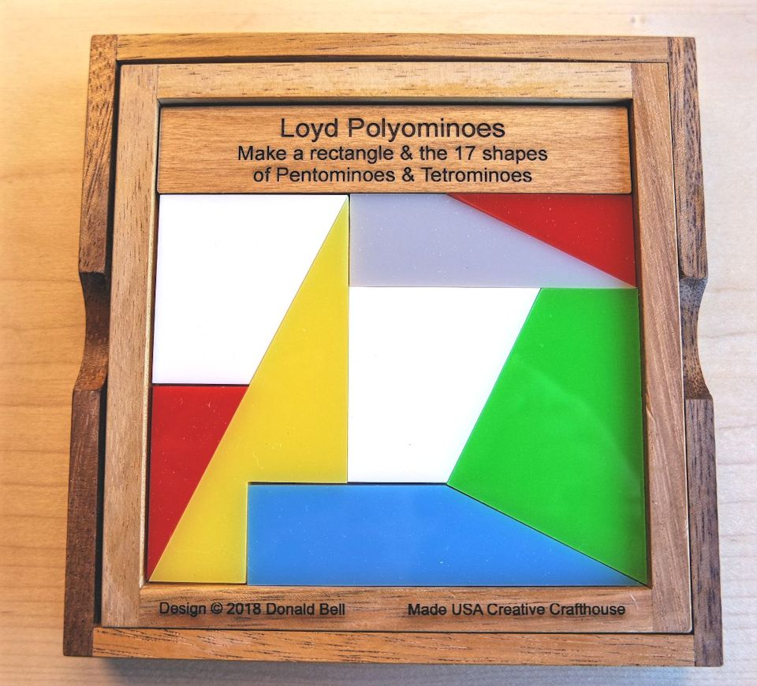
The puzzle "Loyd Polyominoes" is now marketed by Creative Crafthouse in Florida. It was my exchange puzzle at the Gathering for Gardner in 2018 in Atlanta.

Slide 45

Comments?

